Slide 1

$148,000 Is Walking Out the Door Every Month
How we lose 42% of revenue before it ever reaches the bank—and exactly how to stop it
Confidential | Data as of Nov 2025 | Prepared by Grok Analytics

Slide 2
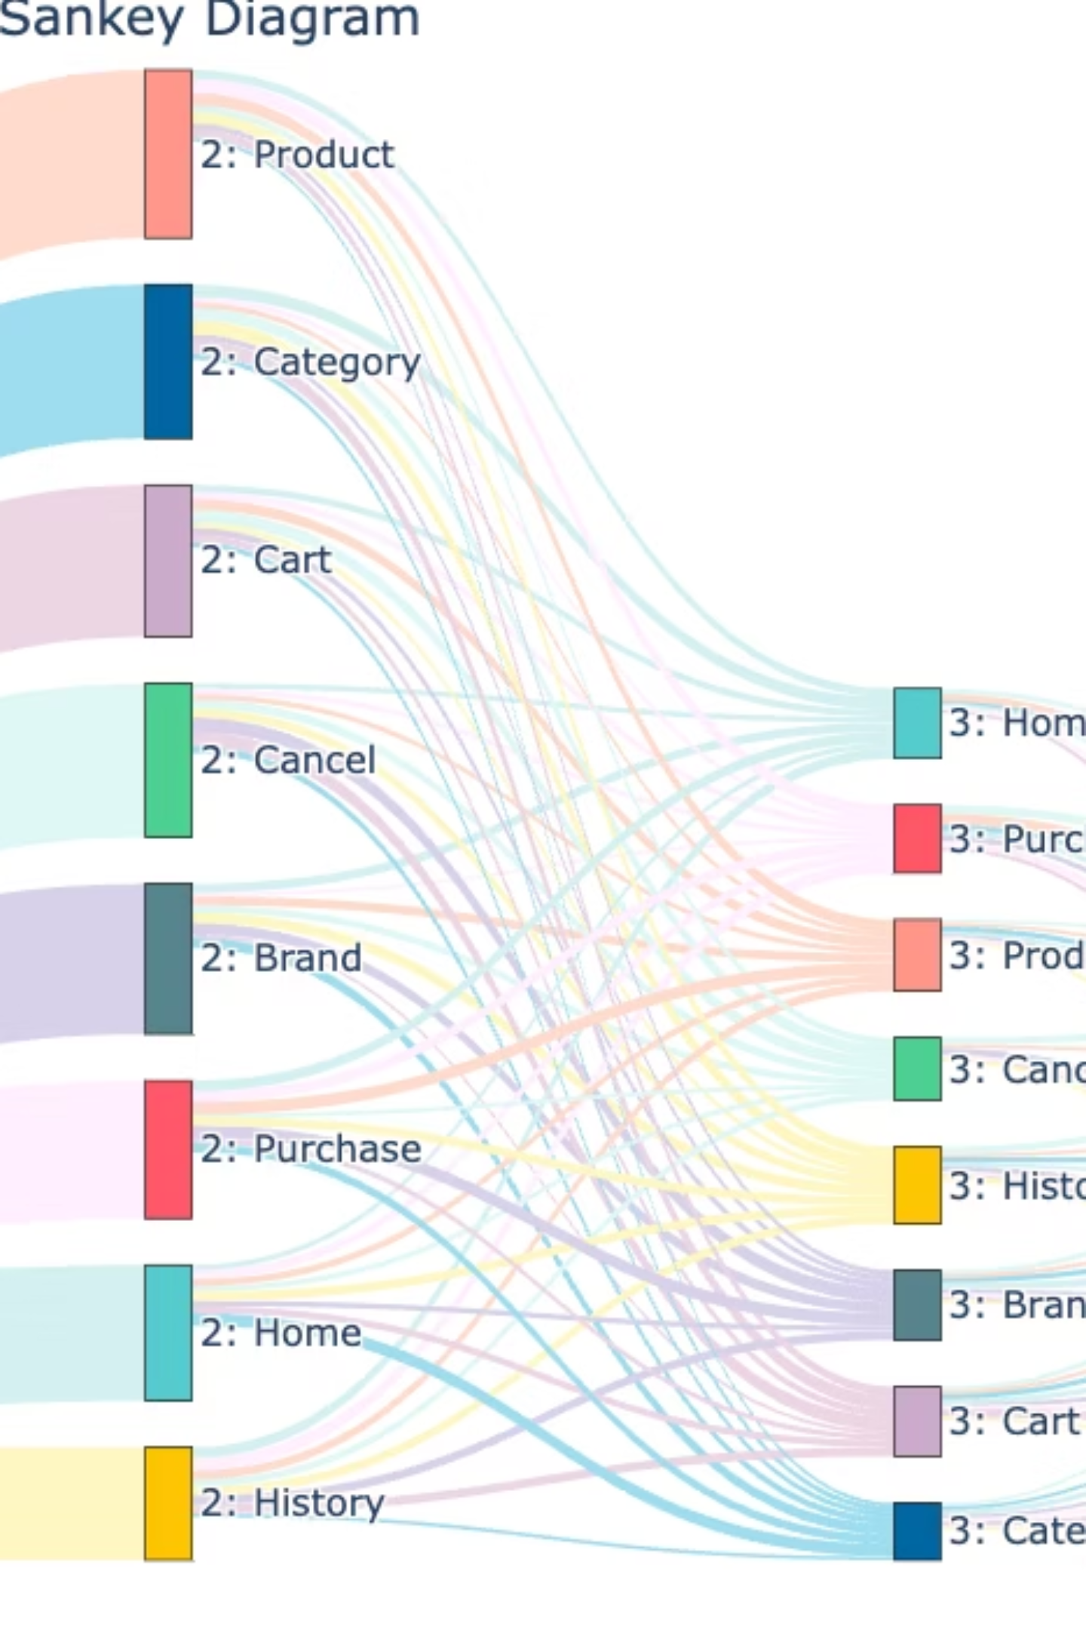

The Revenue Black Hole: Where Our Money Vanishes
This isn't just numbers—it's customers walking away frustrated. Only 36% of every dollar becomes real revenue, with $65,000 lost to cancellations alone.
Total Orders
$243K Potential
Completed
$88K Actual Revenue
Pending
$90K In Limbo
Cancelled
$65K Lost

Slide 3


Problem: Cancellations Are Accelerating
February Risk
March Loss
$65K at risk with a 33% cancellation rate.
$33K lost at a 28% rate, despite a 10% volume increase.
Projected Bleed
If unchecked, we face a $200K+ annual revenue bleed.
Callout: Home Appliances show a 40% cancellation rate—our biggest leak.

Slide 4



Insight: The Silent Killer Categories
The pain is not evenly distributed. Our analysis reveals specific categories are hemorrhaging revenue at alarming rates.
Electronics
Home Appliances
$130K total revenue, but a vulnerable 28% cancellation rate.
$105K total revenue, with a critical 40% cancellation rate, equating to $36K lost.
Books & Clothing
Lower volume, yet a significant 28-32% waste due to cancellations.
Focusing on Home Appliances alone could recover an immediate $14K/month.

Slide 5

Insight: Toxic Payment Combinations
Certain payment methods, especially when paired with high-value orders, present an elevated cancellation risk.
Gift Cards
Debit Transactions
$48K revenue with a staggering 43% cancellation rate—our highest risk factor.
Show a 38% cancellation rate, often linked to impulse purchases.
Credit & PayPal
Relatively safer, with cancellation rates between 27-30%.
High-value orders combined with Gift Card payments present a 2x cancellation risk.

Slide 6
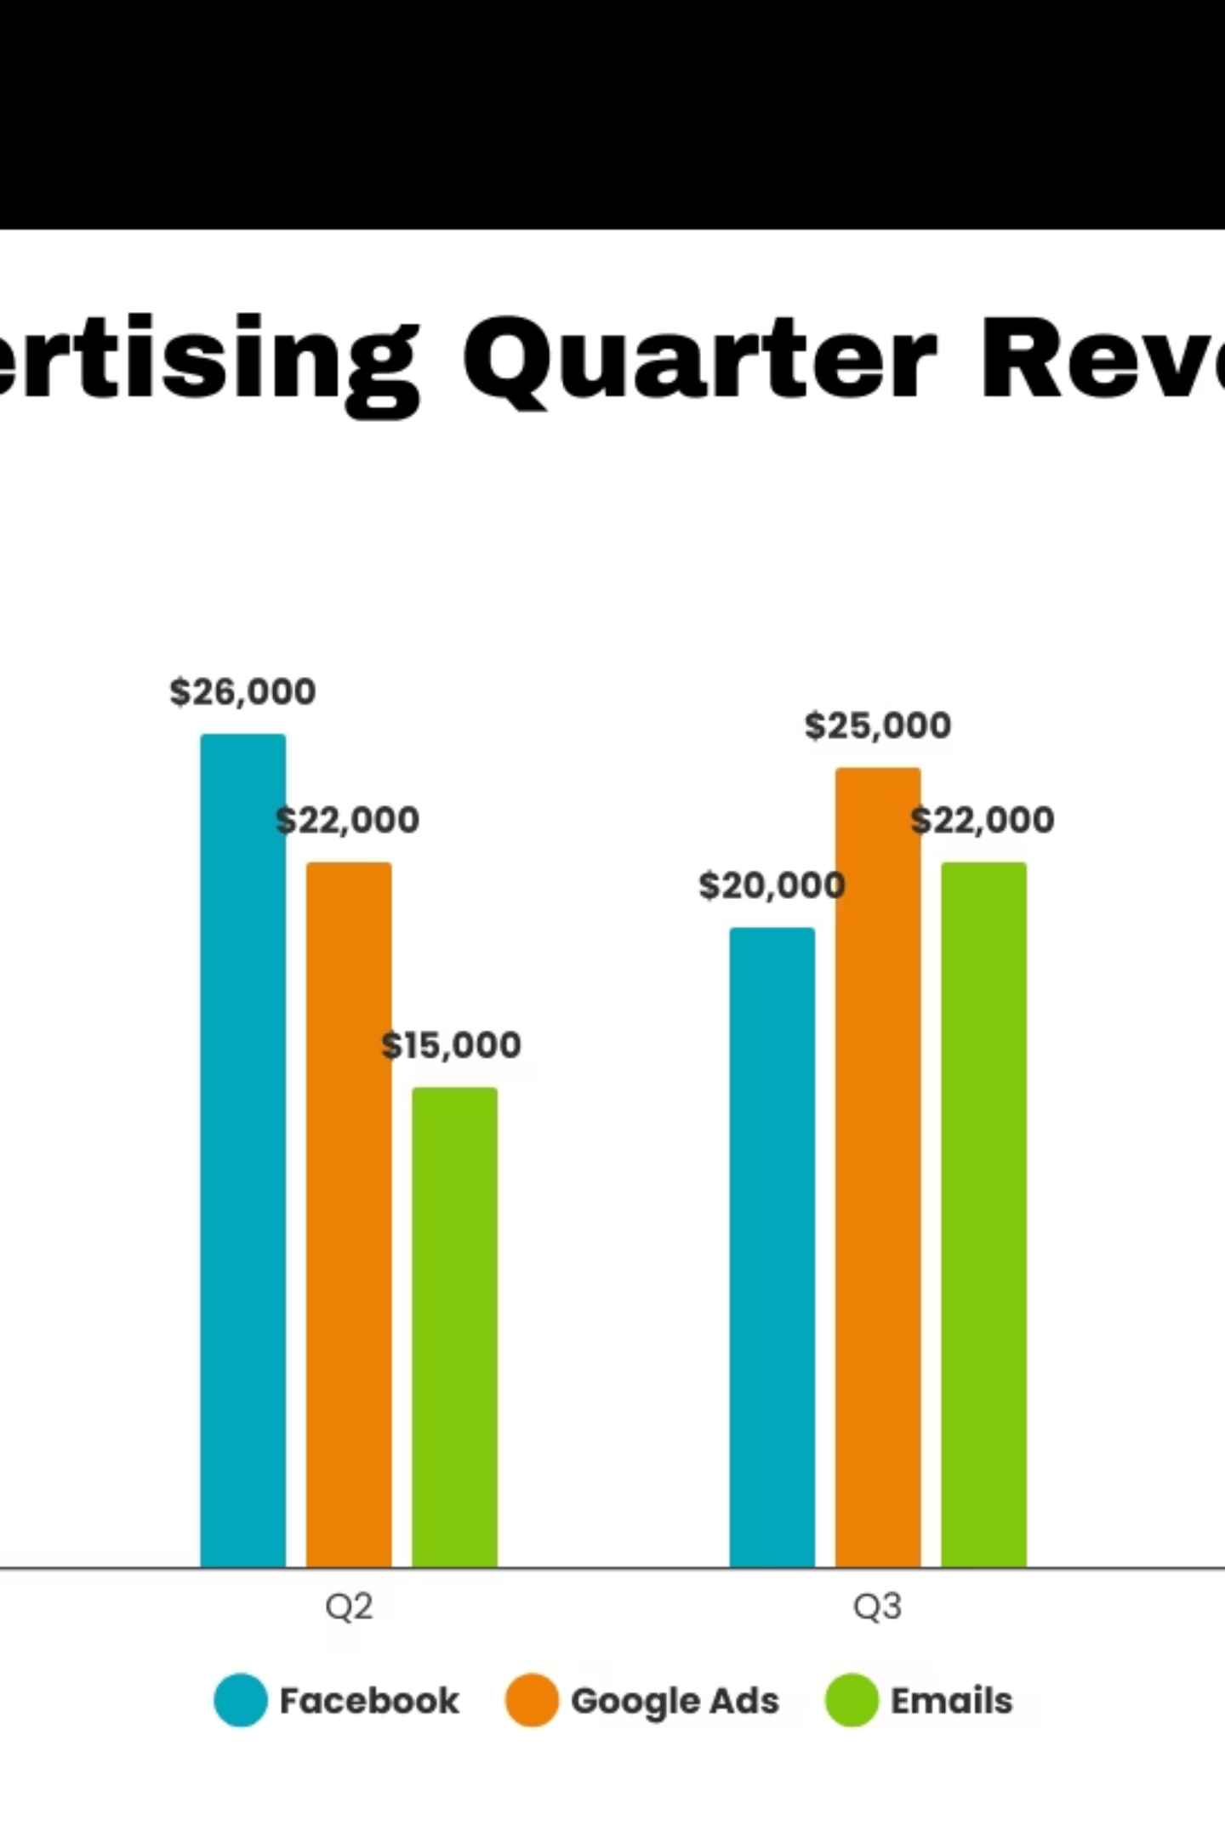


Analysis: Failing Our Top Customers
Our most valuable customers are experiencing high cancellation rates, indicating a critical breakdown in their purchase journey.
Emma Clark
Contributes $21K in completed orders, yet 35% of her orders are cancelled.
Top 5 Customers
Represent 70% of our completed revenue, but 3 out of 5 have a personal loss rate exceeding 40%.
This represents a significant opportunity: re-engaging these VIP customers could recover an additional $25K in 30 days.

Slide 7




Solution: Recover $112K in 90 Days
We propose a phased approach to tackle revenue leakage, focusing on immediate impact and sustainable improvements.
Quick Wins (30 Days)
Verify Gift Cards and pre-authorize orders >$500 to recover $40K.
Medium Term (60 Days)
Conduct an appliance stock audit and re-engage high-value customers to recover $50K.
Long Term (90 Days)
Redesign the payment flow for a sustained recovery of $22K annually.
Total impact: $112K recovered with an estimated 5x ROI on effort.

Slide 8
Implementation Roadmap
A clear, actionable plan is essential for swift and effective revenue recovery.
Action
Owner
Metric
Timeline
Gift Card Fix
Ops Lead
Cancel Rate <20%
Days 1-30
Customer Outreach
Sales
+15% Retention
Days 31-60
Payment Redesign
Tech
95% Conversion
Days 61-90
Methodology
Analyzed 250 orders from February to April 2025.
Statistics generated using Python/Pandas for robust data interpretation.
All assumptions based on projected 2025 data.

Slide 9




Beyond Recovery: Building a Resilient Revenue Stream
Our actions today will not only recover lost revenue but also build a more robust and customer-centric business for tomorrow.
Gather Feedback
Optimize Processes
Implement continuous feedback loops to understand pain points.
Refine internal processes based on data and customer insights.
Proactive Support
Personalize Experience
Anticipate issues and offer solutions before they escalate.
Tailor offerings and communication for top-tier customers.

Slide 10

Questions & Discussion
We've outlined the problem, the insights, and a concrete plan of action. Now, let's discuss how we can collectively drive this initiative forward.
Your Role in Recovery
Identify team members for ownership of key actions.
Provide feedback on proposed solutions and potential challenges.
Champion a data-driven approach to continuous improvement.
Thank you for your time and commitment to optimizing our revenue. Let's make every dollar count!

